Slide 1
Existential Well-Being Counseling
Prof. Dr. Mia Leijssen
University Leuven, Belgium
Mia.leijssen@ppw.kuleuven.be
www.existentieelwelzijn.be

Slide 2
Essential principles of existential well-being counseling
The starting point is experiential: focusing on the bodily felt meaning.
Complexity of Human existence: physical, social, personal, spiritual.
Existential well-being implies sufficient attention for each dimension, not too much, not too little.

Slide 3
3. Integration of diverse humanistic/experiential theories and spiritual traditions. This results in a very broad and varied offer of texts, ordered per existential theme.

Slide 4
4. Positive Psychology. Leads to a process-oriented approach to human strengths, talents and virtues. It should not be understood as a call to ignore negative aspects of human experience. But rather how positive and negative experiences may be interrelated. Gendlin: “Every bad feeling is potential energy toward a more right way of being if you give it space to move toward its rightness."

Slide 5
5. Counseling attitudes and skills from different therapeutic approaches. Foundations are from the person-centered approach: empathy, authenticity, acceptance, appreciation of diversity. 6. Diverse forms of expression: language, imagination, art, music, films, novels, clips from the internet, humoristic sketches… “Beauty and solace” 7. The quality test lies in real life, in the practice of these principles in daily life and work.

Slide 6
Content of the course / 8 Modules
1. Existential Well-being. Quality of life.
Health, Curing and Healing.
2. Life story. Developmental stages.
Existential themes in one’s life story.
3. Dimension of human existence. Self image and World view.
4. Meaning and values.
5. Existential challenges: anxiety, solitude, loss, grief, sickness, death.
6. Conflicts, anger, power, freedom, boundaries.
7. Love. Different forms of connection and closeness. Gender issues.
8. Treasures for life quality. Art of Living.

Slide 7
Development of strengths, qualities and virtues
1. Hope.
2. Resilience, Courage.
3. Wisdom. Self-care
4. Wonder. Awe. Flow. Creativity.
5. Presence. Acceptance.
6. Integrity.
7. Compassion, Responsibility.
8. Joy. Humor. Forgiveness. Gratitude.

Slide 8
1. Existential Well-being. Quality of life, Health, Curing and Healing
“There is an inner wisdom in each person, based in a bodily-carried sense of personal truth. The bodily-held inner knowing becomes a meaningful resource we can use.” (Lucinda Gray)
FOCUSING ATTITUDE
FELT SENSE
HOPE

Slide 9
Example of Personal growth activity
Focus on a time you felt hopeful about your life. What was going on in your life that made you feel hopeful?
What are your qualities or your resources that keep you going on in the face of stress and adversity?
Ward & Reuter (2011). Strenght-centered Counseling. Sage, London.

Slide 10
Example of a Theory: Authentic Happiness (Seligman, 2002) Different routes
the Pleasant Life, having as many pleasures as possible and having the skills to amplify the pleasures.
the Good Life, knowing what your signature strengths are, and then recrafting your work, love, friendship, leisure and parenting to use those strengths to have more flow in life.
the Meaningful Life, using your signature strengths in the service of something that you believe is larger than you are.

Slide 11
Victor Frankl (1946/1963): finding meaning in life is the most urgent need of human beings, especially when basic needs are not fulfilled.
Maslow’s (1962): hierarchy of human needs. Needs for food and shelter, and social support are elementary before some of the ‘being values’ as beauty, goodness, truth and love come in the picture.

Slide 12
2. Human development across the life span. Existential themes in client’s Life story.
AUTHENTICITY
GENUINENESS
SELF-KNOWLEDGE
RESILIENCE
COURAGE
SELF-ESTEEM
SELF-CARE
FORGIVENESS

Slide 13
3. The physical, social, psychological and spiritual dimension of human existence. Self image and World view.
EMPATHIC CURIOSITY
APPRECIATION/TOLERANCE FOR AMBIVALENCE
WISDOM / KNOWLEGDE

Slide 14
Experiential exercises I will offer you a few questions so that you can capture a little bit of the salience of the dimensions in your life.
1. “I am…”

Slide 15
Experiential exercises
2. In what do you invest your time, energy, money ?
3. About what are you worrying in your life ?
4. What gives you joy, pleasure, happiness, peace, strength, courage in your life ?

Slide 16
Dimensions of human existence
Physical
Social
Personal
Spiritual

Slide 17
Physical dimension

Slide 18
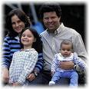
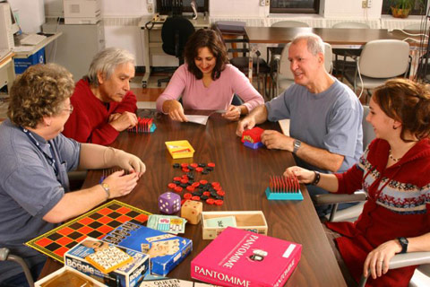
Social dimension

Slide 19
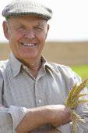
Psychological dimension

Slide 20
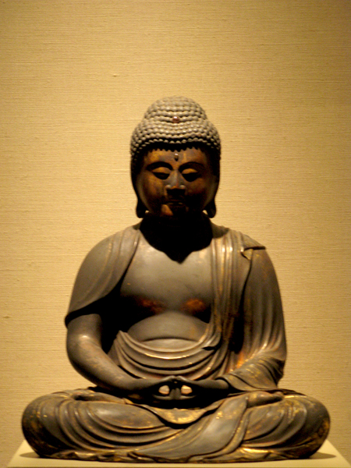
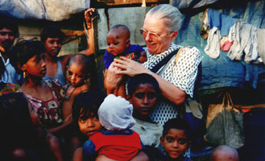
Spiritual dimension

Slide 21
Dimensions of Human Existence (Leijssen, 2007; van Deurzen, 2009)
 | Physical Umwelt | Social Mitweld | Personal Eigenwelt | Spiritual Uberwelt
I AM … Deals with | Body Material world Nature | Place in society Relations | Identity Character traits Thinking Feeling | Soul Meaning Self-transcending ideals
ENERGY, time, money Values | Health Safety Comfort | Esteem Succes Connection | Autonomy Freedom Knowledge Authenticity | A better world, Consciousness of unity ‘Being values’
WORRIES Threats | Pain, sickness Death Poverty | Rejection Loneliness Guilt Shame | Confusion Doubt Imperfection | Meaninglessness Futillity Evil
JOY Perenial philosophy | BEAUTY | GOODNESS | TRUTH | LOVE

Slide 22
4. Meaning and values.
MOTIVATION
GOALS
COMMITMENT
PASSION
ZEST
ENTHUSIASM
FLOW
WONDER, AWE

Slide 23
5. Existential challenges: anxiety, solitude, loss, grief, sickness, death
EMOTIONS
ACCEPTANCE
PRESENCE

Slide 24
RESEARCH AND MEASUREMENTS
Mount et al. (2007). Healing Connections: On Moving from Suffering to a Sense of Well-Being. Life-threatening illness is an assault on the whole person: physical, psychological, social, and spiritual. It frequently presents caregiver and sufferer with a paradox suffering does not correlate with physical well-being alone. Drawing on a purposive sample of 21 participants, a phenomenological study was carried out to explore the relevance of the existential and spiritual domains to suffering, healing, and quality of life (QOL). The phenomenological method was used to achieve an in-depth description of both existential suffering, and conversely, the experience of integrity and wholeness, in persons with life-threatening illness; identify ‘‘inner life’’ and existential contributors to suffering and subjective well-being in advanced illness; and develop a narrative account of these QOL extremes. The importance of meaning-based adaptation to advanced illness was supported, as were Frankl’s sources of meaning and Yalom’s sources of existential anguish. Divergent themes characteristic of the two QOL extremes were identified. Four types of ‘healing connections’ involving a sense of bonding to Self, others, the phenomenal world, and ultimate meaning, respectively, were identified. They situated the participant in a context that was greater and more enduring than the self, thus leading to enhanced meaning and QOL.

Slide 25
Birdwings. Rumi (1207-1273)
Your grief for what you’ve lost lifts a mirror up to where you’re bravely working.
Expecting the worst, you look, you look, and instead, here's the joyful face you’ve been wanting to see.
Your hand opens and closes and opens and closes. If it were always a fist or always stretched open, you would be paralyzed.
Your deepest presence is in every small contracting and expanding, the two as beautifully balanced and coordinated as birdwings.

Slide 26
6. Conflicts, anger, power, freedom, boundaries.
CONFRONTATION
CONFLICT
FAIRNESS
INTEGRITY
LEADERSHIP
VIRTUE ETHICS

Slide 27
Marianne Williamson. Nelson Mandela presidential inauguration speech (1994).
“Our deepest fear is not that we are inadequate. Our deepest fear is that we are powerful beyond measure. It is our light, not our darkness that most frightens us. We ask ourselves, Who am I to be brilliant, gorgeous, talented, fabulous? Actually, who are you not to be? You are a child of God. Your playing small does not serve the world. There is nothing enlightened about shrinking so that other people won't feel insecure around you. We are all meant to shine, as children do. We were born to make manifest the glory of God that is within us. It's not just in some of us; it's in everyone. And as we let our own light shine, we unconsciously give other people permission to do the same. As we are liberated from our own fear, our presence automatically liberates others.”

Slide 28
7. Love. Different forms of connection and closeness… Gender issues.
ATTACHMENT
DESIRES
ROMANTIC LOVE
FRIENDSHIP
KINDNESS
GENEROSITY
CARE
COMPASSION
ALTRUISM
RESPONSIBILITY

Slide 29
“The ability of human beings to form loving bonds is possibly one of their greatest strengths.” (Aspinwall & Staudinger, 2002)

Slide 30
Exercise: Exploring different ways ‘love’ can manifest to you. Rate yourself with each item on a scale: 0 (nonexistent for you) to 5 (dominantly present).
Physical level: Love as vital force.
1. I enjoy tasty food and/or good sex and/or physical activities and/or sensorial excitement.
2. I care for my health.
3. I care for material things needed for living.
4. I appreciate beautiful objects and/or physical comfort.
5. Rhythm and beauty of nature has a hold on me.
6. I care for the environment.
7. I feel one with nature.

Slide 31
Social level: Love as compassion.
1. I behave in a friendly way with one and all.
2. I do invest in others.
3. I mainly tend to see the good in others.
4. I like to care for others and find pleasure in helping them.
5. I accomplish my social duties in a loving way.
6. I love to be in the company of others.
7. I feel part of humanity.

Slide 32
Personal level: Love as positive feelings.
1. I foster positive feelings and ideas.
2. About my work I can say: “This procures me joy.”
3. I know and accept myself as I am.
4. I create possibilities to learn and to develop.
5. I give myself time for leisure.
6. I feel gratitude for what is.
7. I foster my precious inner core.

Slide 33
Spiritual level: Love as being.
1. I give without expectation of any return.
2. I want to contribute to a better world for one and all.
3. I show respect for everything around me
4. I experience a realm of inner peace.
5. I feel inspired and tend to radiate it.
6. I have deep feelings of oneness with all that exists.
7. To love is my real being.

Slide 34
The history of love highlights four traditions, denoted by Greek terms:
Eros: search for the beautiful
Philia: affection in friendship
Nomos: obedience to the divine
Agape: self-transcended love

Slide 35
In Sternberg’s theory (1986) all types of love are made up of different combinations of these three components:
Passion, or physical attractiveness and romantic drives
Intimacy, or feelings of closeness and connectedness
Commitment, involving the decision to initiate and sustain a relationship

Slide 36
Compassion (Tara Brach)
Compassion can be described as letting ourselves be touched by the vulnerability and suffering that is within ourselves and all beings.
As you move through your day and encounter different people, slow down enough to ask yourself a question. “What is life like for this person? What does this person most need?”

Slide 37
Love as the necessary condition for growth and healing = connection
Physical dimension: being part of nature; respecting the body and it’s needs; love for the material dimension.
Social dimension: authentic connection with others; genuine commitment to social tasks.
Personal dimension: connection with oneself; self-knowlegde; self-love; rich inner life.
Spiritual dimension: inspired by something that transcends the limited self; love is the whole being

Slide 38
8 .Treasures for life quality. Art of living.
INTUITION
IMAGINATION
CREATIVITY
HUMOR
PLAYFULNESS
DISCIPLINE
GRATITUDE
TRANSCENDENCE

Slide 39
One year course in an electronic learning environment
Everything is ONLINE (login password)
Powerful set of web-based tools for an array of activities. (Course management by Moodle)
Articles
Video’s
Internet links
Discussion Forum
Reflection Forum
Chat-room
Skype

Slide 40
One year course in an electronic learning environment
Intense, personal
and encouraging follow-up by the staff and mentors
Only online contact
Staff members:
Prof. Dr. Mia Leijssen
Claude Missiaen
Chris Van de Veire
Person-Centered/
Experiential/Existential therapists

Slide 41
One year course in an electronic learning environment
Admission: bachelor in human sciences
Selection on the basis of motivation and working context.
Participants from different backgrounds: psychotherapists, medical doctors, PHD in philosophy, business, magistrate, nursery…
The training leads to University Leuven Certificate Counseling in Existential Well-Being.

Slide 42
One year course in an electronic learning environment
Studying time: personal choice
Basic program minimum weekly 5 hours
Deepening program + weekly 5 hours
Extension program + weekly 5 hours
Time efficiency: flexible course ‘attendance’
No travel costs nor time
Flexible combination work/family/study

Slide 43
Strenghts e-learning
Students have interval time to react on the forums. This provides more reflection time.
Reactions are well-considered, ripe, personal and with great depth and a high degree of personal involvement, more in contact with what is really there. The e-learning environment is not like ‘sending e-mails’, it’s more like ‘writing letters’.
Low threshold to post issues on the website. Delicate themes can more easily be discussed in an online environment.
Students can open new discussion lines themselves, so they give their own colours to the training.
High level of involvement in group process with high degree of interpersonal learning.

Slide 44
Weaknesses e-learning
No direct face to face contact between participants and staff. It takes more time to develop a feeling of being connected with the group.
No direct feedback about ones interventions. No direct interactions, except for the meetings in the chat-rooms.
Worst case scenario: a participant may not be who he/she pretends he/she is.

Slide 45
Course members’ testimonies
Years ago, studying was an obligation, often something like “couldn’t care less”. Here, “learning” is mere pleasure. The material is very interesting and it gives you a broader view and more opportunities to apply existential understanding in your own life and also in your own counseling practice. Existential well-being in practice!!! I am enthousiastic about the mentors’ open minds. A real “pearl”. (Jo Mattens)
So far, I have enjoyed this training enormously, I have learned quite a lot and it has absolutely made me a richer person. As of day 1, I found it a privilege, a unique chance to be admitted to follow this training. It is simply a lovely gift that still gives me pleasure every day. (Annemie Vandermeulen)

Slide 46
Course members’ testimonies
In our society’s bustle and abundance, I feel this course is a permanent invitation to stick to the essentials or to return to these essentials. It is a great privilege, in that context, to be admitted to enjoy the mentors’ beneficial, positive and supporting presence. I really feel this is making me a ‘better’ and more ‘satisfied’ person. (Marijke Merckx)
For anyone who is committed to his soul’s care and that of his fellow-man, anyone who feels part of a larger whole, I can only recommend this course. The contents are absolutely useful in practice and the mentors guide you perfectly. Even though this is an online training, which feels a bit uncomfortable at the beginning, I would gladly do it over. (Nicky Demoitié)

Slide 47
References
Blackmore, C., van Deurzen, E. & Tantam, D. (2007) Therapy training online- using the internet to widen access to training in mental health issues. In: Theo Stickley and Thurstine Basset (eds) Teaching and learning about mental health. Wiley.
van Deurzen, E., Blackmore, C., & Tantam, D. (2006) Distance and Intimacy in Internet Psychotherapy Training. International Journal of Psychotherapy, special edition, Vol. 10, No. 2.
van Deurzen, E. (2009). Psychotherapy and the Quest for Happiness. London: Sage.
Leijssen, M., Tijd voor de ziel (2007). Tielt: Lannoo
Snyder, C.R., S.J. Lopez & J.T. Pedrotti, (2011). Positive Psychology. The Scientific and Practical explorations of Human Strengths. Second edition. Sage Publications.
Ward & Reuter (2011). Strenght-centered Counseling. Sage, London.

Slide 48
Thank you
Pictures included are made during the course by
Monique van den Boogaard

